Slide 1

Social Impact
Private Rented Licensing

Slide 2


About the project
Social Impact…
… broader definition of value
changes to the wellbeing (impacts)…
… individuals, communities, wider city and environment
Notes:
Social impact is about capturing a broader definition of value that includes the worth or importance stakeholders place on changes to their wellbeing (impact) that are not captured through traditional accounting. We’re asking, what impact does Private Rented Licensing have on the wellbeing of individuals, communities, the wider city and the environment?
The aim is to robustly evidence what those impacts are, and through learning more about what the impacts are and how they occur, to inform decision-making to maximise the positive impacts in the future.

Slide 3












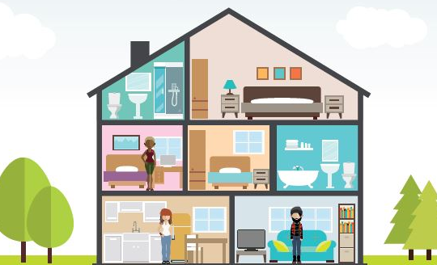








What does that mean?
Environment
Wider city
Communities
Tenants
Landlords
Notes:
Housing provides the foundation for our standard of living – Beveridge in 1944 said “The greatest opportunity open in this country for raising the general standard of living lies in housing” That’s the vision for Private Rented Licensing – to make sure all housing provide homes fit for the future, by sustaining improved standards in the private sector.
Who’s affected? This impacts the people who live and work in the private sector. The main intended beneficiary is tenants living in privately rented homes. Landlords are also affected by licensing.
We’re asking, what are those effects? How are people’s health, work and study, employment, businesses affected by the changes that occur as a result of licensing? And what other changes are happening that we might not be aware of – good or bad, intended or unintended. The first element of the impact assessment is to ask people, what changes? And which changes are most important?
What changes in the communities around those properties? How does it affect crime and safety, waste, the look and feel of the streets and neighbourhoods, the relationships between the community?
What are the wider knock-on effects in the longer term? How does it affect healthcare, universities, police and emergency services, local government departments, and what other long-term effects?
And what impact does it have on the environment?
After identifying what the most important changes are, the next step in the impact assessment is to measure to what extent they’ve occurred, how many people have been affected. And finally to put a value on that – including things not traditionally included in financial accounts, such as the value to people’s wellbeing, the value to the community, the value to the environment.
The aim is, by understanding what the impacts of licensing are, and how they unfold, we can learn from this to influence decision-making, to improve that long-term positive impact.

Slide 4
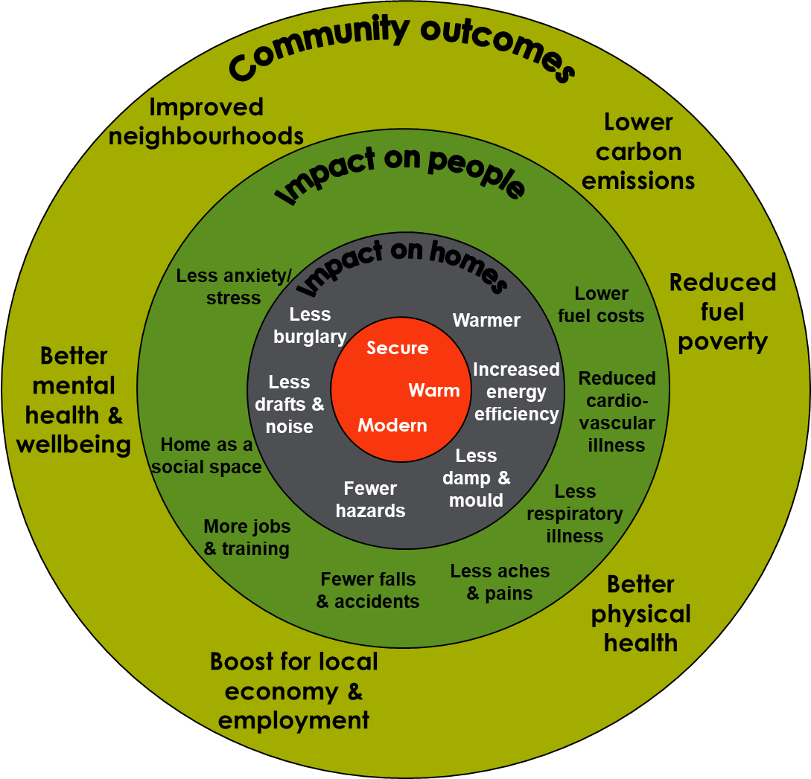
A real-world example
Notes:
We wanted to share with you an example of how the social impact approach, and specifically Social Return on Investment, has been used in a relevant context, to show what it looks like. However, this hasn’t been done in the Private Rented sector before, certainly not for licensing – this will be first of a kind. So most relevant example is in the social housing sector – recognising the details of this will be different, but just to give you an example of what a social impact study looks like and how it can be used.
Some of you may remember the Decent Homes programme in the social housing sector, which was a programme of works to bring social housing stock up to a minimum acceptable standard. At the time, there was lots of stats about the number of improvements made to properties, but nothing about what effect this was having on people living in the homes, and the wider communities – i.e. the social impact of Decent Homes.
We did a two-year impact study with Nottingham City Homes and Nottingham Business school to measure the wider impact. We looked at the effects on:
Health and wellbeing
Crime and antisocial behaviour
Energy efficiency and fuel poverty
Employment and the local economy
The social impact study of the Decent Homes programme in Nottingham revealed some interesting things:
Security was increased by replacing windows and doors- for example working with police data showed forced entry via a window halved. People felt safer as a result. And they were also warmer, because the windows were more energy efficient. At the time, only old doors or those in disrepair were being replaced, but the evidence of the multiple social benefits of having secure, energy efficient doors meant NCH prioritised a complete door replacement programme.
Energy efficiency was also improved, through insultation, new windows and doors and boiler replacements. This improved the EPC ratings of properties and reduced emissions. It saved tenants money on their fuel bills. And it also improved the health of vulnerable people living in those properties. But a learning point from the study was that full benefits could only be achieved if residents were supported to make the best of new installations, so resident education recognised as an additional element needed and NCH created a Fuel Poverty officer position.
Decent Homes was a huge investment programme, with £187m spent. But when all the wider social impacts were taken into account, it showed that every £1 invested in Decent Homes created £4.76 in wider social, economic and environmental benefits.

Slide 5



What does this mean for you?
Landlord and Agent Forum – Weds 8th January 2025, 3.30pm
Landlord and Agent survey – TBC
Tenant consultations and survey
Any questions:
Sophia.Beswick@nottinghamcity.gov.uk
Notes:
The heart of social impact is understanding what changes from the perspective of those who are most impacted
First stage is open consultation to understand what changes and how, and the relative importance of those changes
All voices of those who are impacted – you as landlords, agents and others in the industry, as well as tenants, neighbours, and wider city stakeholders
So we will have an initial consultation or discussion group
Next stage is to measure how many people are affected, which is likely to take the form of an online survey, which you will be notified about via the landlord newsletter – please be encouraged to take part
We will also be working with your tenants to capture their views, via similar means – consultation sessions and online survey

